Slide 1
mesoBeenz

Slide 2
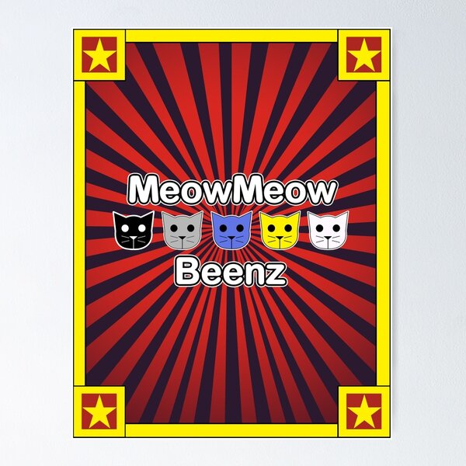
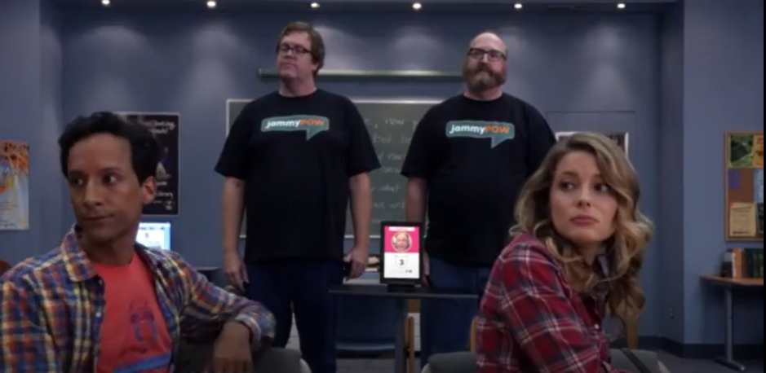
Beenz…with two E’s and a Z

Slide 3
Background: MesoMake
MesoMake [1]
A program I wrote
Python
Randomly generates granular/porous mesostructured
Randomly initializes circled
Resolves overlaps
2D or 3D
Features
Domain decomposition
Partial remapping
Sobol distribution reduces initial overlaps
Allows distributions of grain/pore radii
Limited to spherical particles/pores
[1] T. M. Russell. MesoMake. Unpublished

Slide 4
Goal of these programs: Generate realistic meso-structures
[2] Skidmore, Cary & Phillips, D.S. & Howe, Philip & Mang, Joseph & Romero, J.A.. (1998). The evolution of microstructural changes in pressed HMX explosives. 10.2172/334323.
[1] T. M. Russell. MesoMake. Unpublished

Slide 5
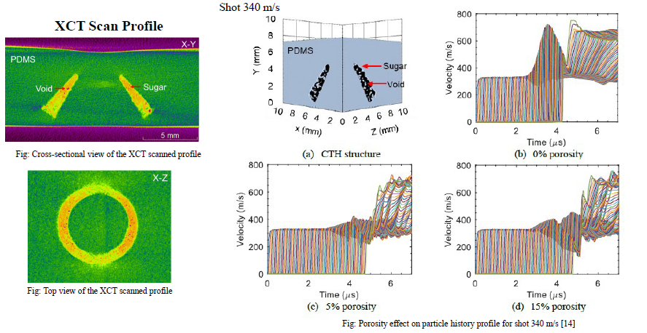
In [3]
Used mesoMake to incorporate porosity in sugar cone mesostructured
Inclusion of porosity improved resemblance of simulation to experimental measurements
Porosity diminished maximum velocity
[3] R. Mahbub, T. M. Russell, J. D. Borg, R. Coutu, and J. P. Borg, “Geometric Optimization of a Functional Meso-structure with DAKOTA for Surrogate Energetic Heterogeneous Mixture”. AIP Conference, SCCM—2023. Under Review.

Slide 6
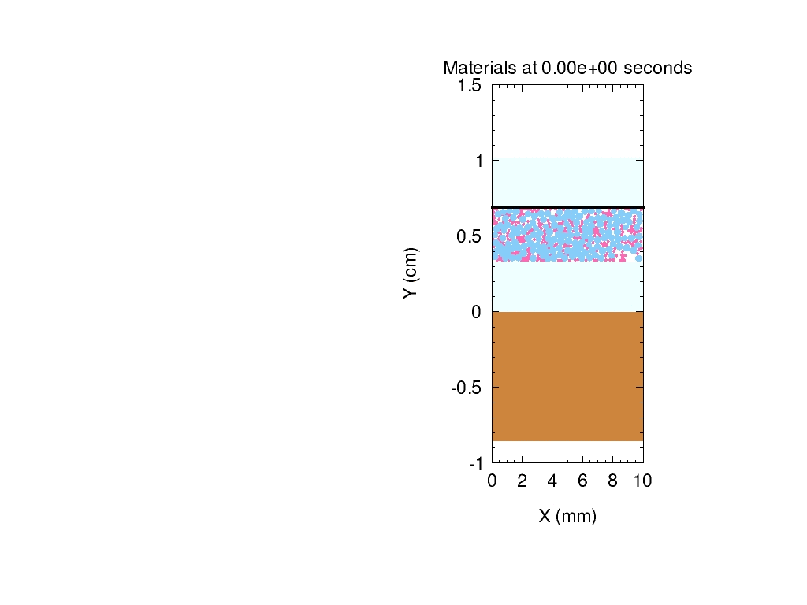
In [4]
Rafee conducted a shot on 80% sugar-20% PDMS binder mixture [4]
I used mesoMake to generate porous mixture of 2 constituents
Varied porosity to try to replicate experimental results
[4] Raffee Mahbub. Investigating The Dynamic Response of Surrogate Energetic Systems with Variable Geometric Complexity. PhD Thesis, Marquette University. May 2024.

Slide 7
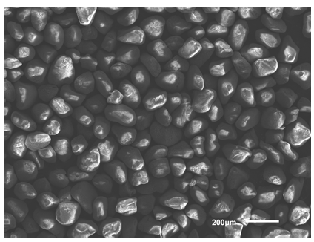
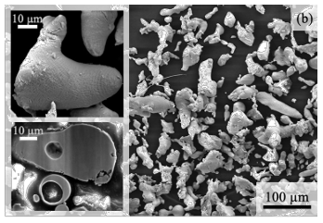
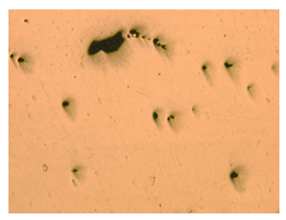
Real meso/micro-structural features are not always spherical
[5] J.W. LaJeunesse, “Dynamic Behavior of Granular Earth Materials Subjected to Pressure-Shear Loading”. PhD Thesis. Marquette University. 2018.
[2] Skidmore, Cary & Phillips, D.S. & Howe, Philip & Mang, Joseph & Romero, J.A.. (1998). The evolution of microstructural changes in pressed HMX explosives. 10.2172/334323.
[7] Jiang, R., Monteil, L., Kimes, K., Mostafaei, A., & Chmielus, M. (2021). Influence of powder type and binder saturation on binder jet 3D–printed and sintered Inconel 625 samples. The International Journal of Advanced Manufacturing Technology, 116, 3827-3838.
[6] Rawn, Penn, "Reducing Porosity in LPBF TI-6AL-4V by Parameter Optimization and Low Temperature Hot Isostatic Pressing Cycle" Master's Theses. Marquette University 2023.

Slide 8
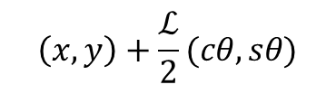
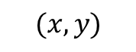
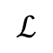
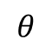
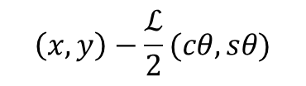
Beenz
The limited geometry of MesoMake can be advanced by connecting spheres into beenz
A been is composed of two connected circles
Coordinate refers to circle center
Thus far, circles have equal radii
Circle centers can easily be found with some trig
Later, this can be broadened into many spheres
$$\left(x,y\right)+\frac{ℒ}{2}(cθ,sθ)$$
$$(x,y)$$
$$ℒ$$
$$θ$$
$$\left(x,y\right)−\frac{ℒ}{2}(cθ,sθ)$$

Slide 9
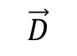
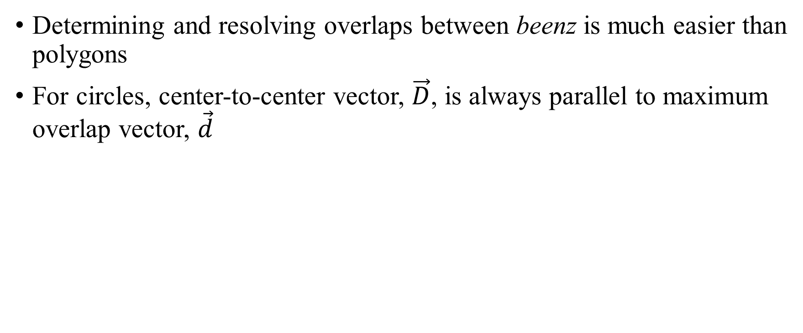
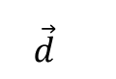
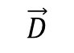
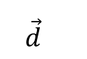
Beenz vs. Polygons
Determining and resolving overlaps between beenz is much easier than polygons
For circles, center-to-center vector, $\vec{D}$, is always parallel to maximum overlap vector, $\vec{d}$
$$\vec{D}$$
$$\vec{D}$$
$$\vec{d}$$
$$\vec{d}$$

Slide 10
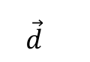
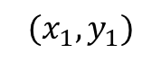
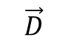
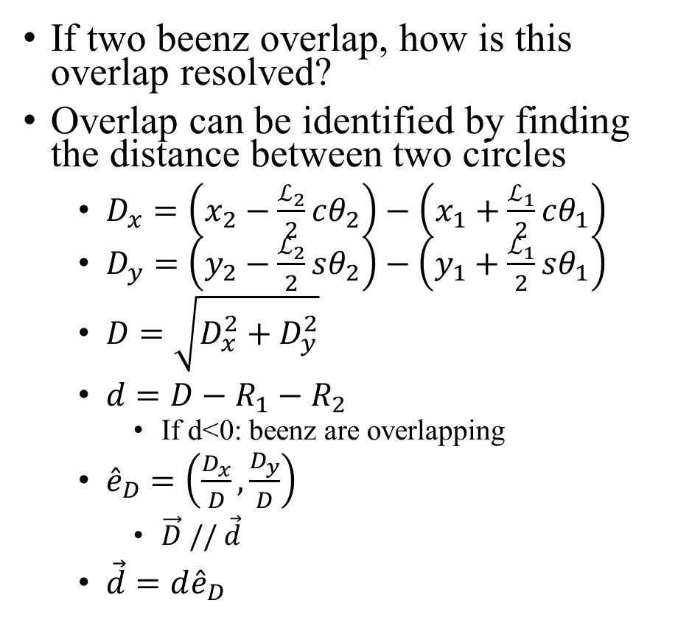
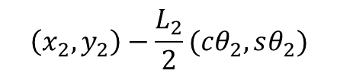
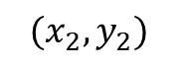
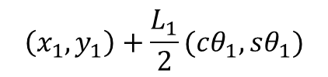
When beenz collide
$$\vec{D}$$
$$\vec{d}$$
If two beenz overlap, how is this overlap resolved?
Overlap can be identified by finding the distance between two circles
$D_{x}=\left(x_{2}−\frac{ℒ_{2}}{2}cθ_{2}\right)−\left(x_{1}+\frac{ℒ_{1}}{2}cθ_{1}\right)$
$D_{y}=$ $\left(y_{2}−\frac{ℒ_{2}}{2}sθ_{2}\right)−\left(y_{1}+\frac{ℒ_{1}}{2}sθ_{1}\right)$
$D=\sqrt{D_{x}^{2}+D_{y}^{2}}$
$d=D−R_{1}−R_{2}$
If d<0: beenz are overlapping
${\hat{e}}_{D}=\left(\frac{D_{x}}{D},\frac{D_{y}}{D}\right)$
$\vec{D} // \vec{d}$
$\vec{d}=d{\hat{e}}_{D}$
$$\left(x_{1},y_{1}\right)+\frac{L_{1}}{2}(cθ_{1},sθ_{1})$$
$$(x_{2},y_{2})$$
$$(x_{1},y_{1})$$
$$\left(x_{2},y_{2}\right)−\frac{L_{2}}{2}(cθ_{2},sθ_{2})$$

Slide 11
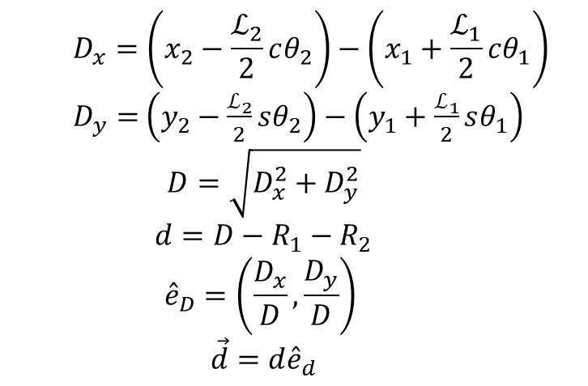
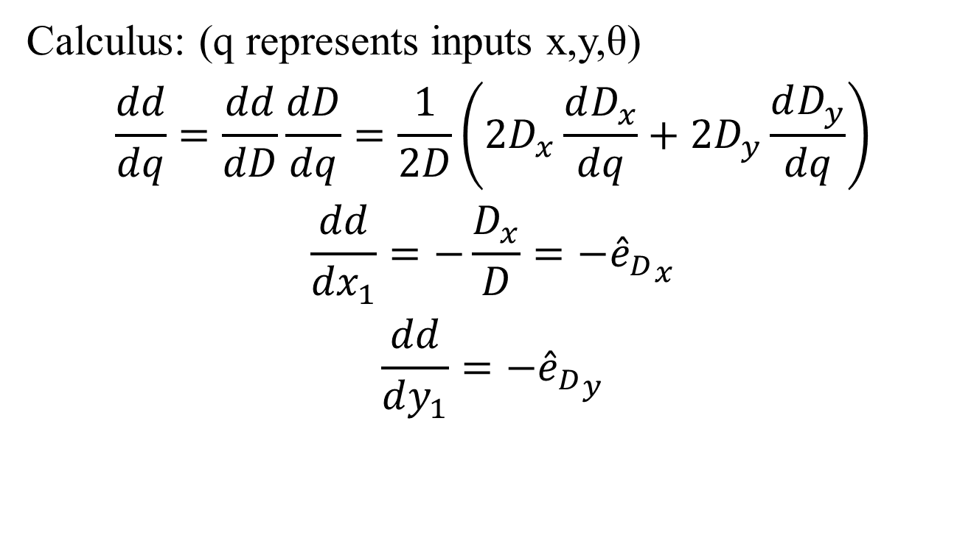
Resolving overlap: x & y
$$D_{x}=\left(x_{2}−\frac{ℒ_{2}}{2}cθ_{2}\right)−\left(x_{1}+\frac{ℒ_{1}}{2}cθ_{1}\right)$$
$D_{y}=$ $\left(y_{2}−\frac{ℒ_{2}}{2}sθ_{2}\right)−\left(y_{1}+\frac{ℒ_{1}}{2}sθ_{1}\right)$
$$D=\sqrt{D_{x}^{2}+D_{y}^{2}}$$
$$d=D−R_{1}−R_{2}$$
$${\hat{e}}_{D}=\left(\frac{D_{x}}{D},\frac{D_{y}}{D}\right)$$
$$\vec{d}=d{\hat{e}}_{d}$$
Calculus: (q represents inputs x,y,θ)
$$\frac{dd}{dq}=\frac{dd}{dD}\frac{dD}{dq}=\frac{1}{2D}\left(2D_{x}\frac{dD_{x}}{dq}+2D_{y}\frac{dD_{y}}{dq}\right)$$
$$\frac{dd}{{dx}_{1}}=−\frac{D_{x}}{D}={{−\hat{e}}_{D}}_{x}$$
$$\frac{dd}{dy_{1}}=−{{\hat{e}}_{D}}_{y}$$
These match mesoMake

Slide 12
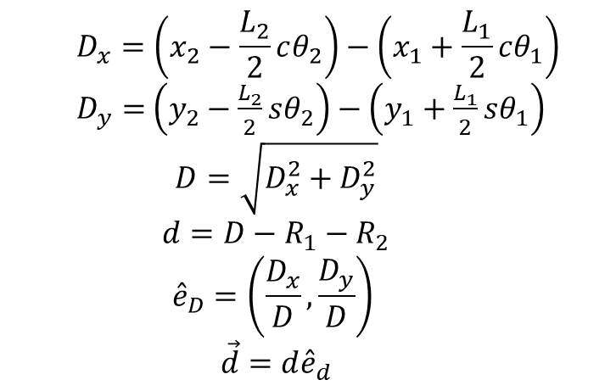
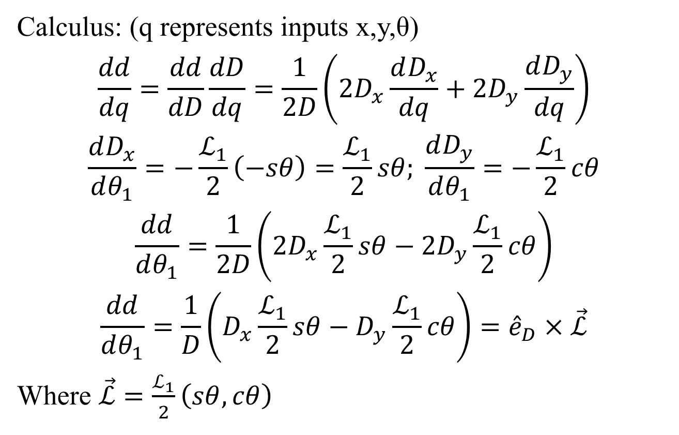
Resolving overlap: θ
$$D_{x}=\left(x_{2}−\frac{L_{2}}{2}cθ_{2}\right)−\left(x_{1}+\frac{L_{1}}{2}cθ_{1}\right)$$
$D_{y}=$ $\left(y_{2}−\frac{L_{2}}{2}sθ_{2}\right)−\left(y_{1}+\frac{L_{1}}{2}sθ_{1}\right)$
$$D=\sqrt{D_{x}^{2}+D_{y}^{2}}$$
$$d=D−R_{1}−R_{2}$$
$${\hat{e}}_{D}=\left(\frac{D_{x}}{D},\frac{D_{y}}{D}\right)$$
$$\vec{d}=d{\hat{e}}_{d}$$
Calculus: (q represents inputs x,y,θ)
$$\frac{dd}{dq}=\frac{dd}{dD}\frac{dD}{dq}=\frac{1}{2D}\left(2D_{x}\frac{dD_{x}}{dq}+2D_{y}\frac{dD_{y}}{dq}\right)$$
$$\frac{dD_{x}}{dθ_{1}}=−\frac{ℒ_{1}}{2}\left(−sθ\right)=\frac{ℒ_{1}}{2}sθ; \frac{dD_{y}}{dθ_{1}}=−\frac{ℒ_{1}}{2}cθ$$
$$\frac{dd}{dθ_{1}}=\frac{1}{2D}\left(2D_{x}\frac{ℒ_{1}}{2}sθ−2D_{y}\frac{ℒ_{1}}{2}cθ\right)$$
$$\frac{dd}{dθ_{1}}=\frac{1}{D}\left(D_{x}\frac{ℒ_{1}}{2}sθ−D_{y}\frac{ℒ_{1}}{2}cθ\right)={\hat{e}}_{D}×\vec{ℒ}$$
Where $\vec{ℒ}=\frac{ℒ_{1}}{2}\left(sθ,cθ\right)$

Slide 13
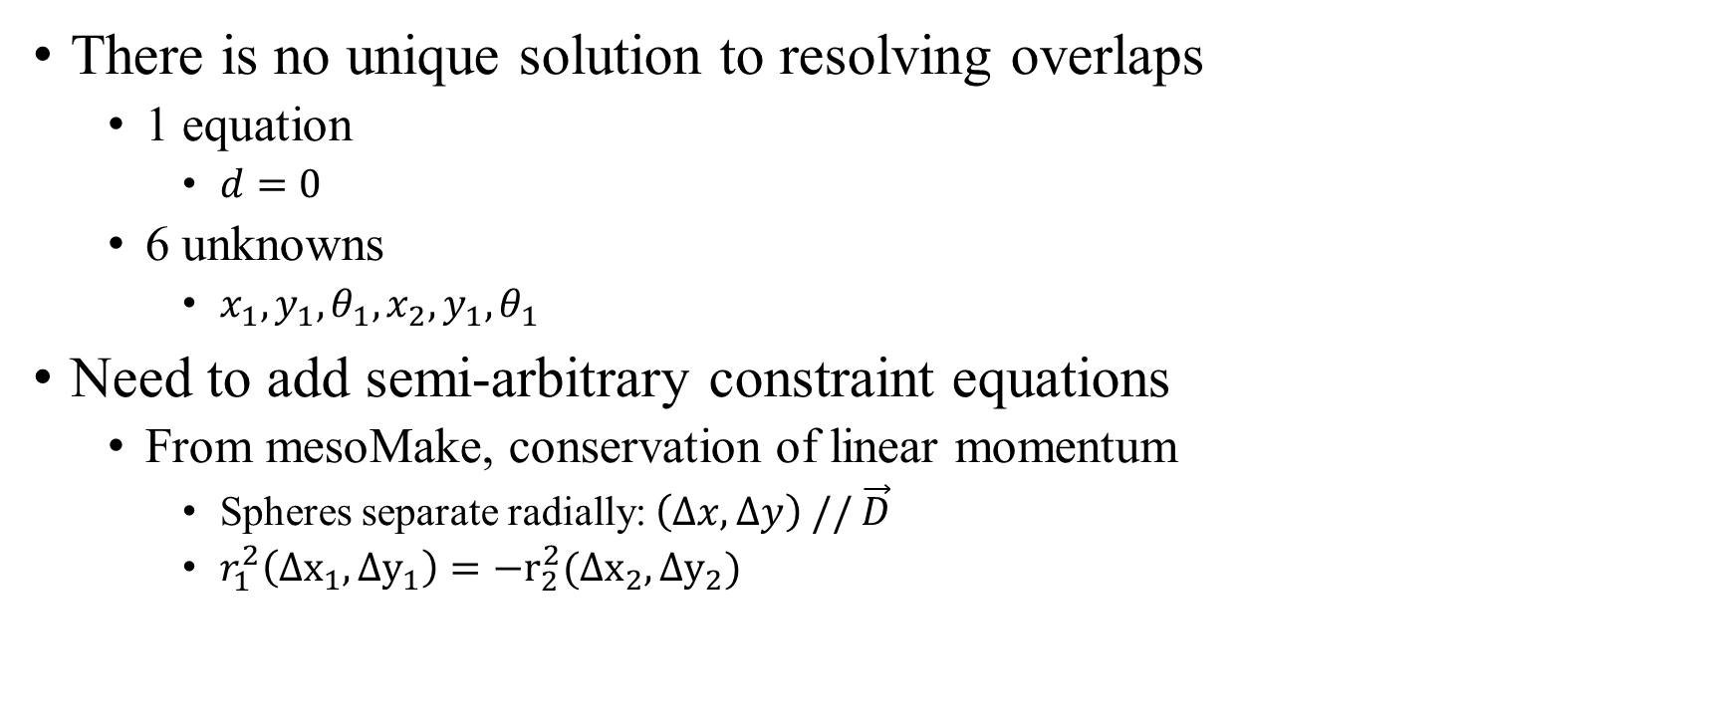
Best solution
There is no unique solution to resolving overlaps
1 equation
$d=0$
6 unknowns
$x_{1},y_{1},θ_{1},x_{2},y_{1},θ_{1}$
Need to add semi-arbitrary constraint equations
From mesoMake, conservation of linear momentum
Spheres separate radially: $\left(Δx,Δy\right) // \vec{D}$
$r_{1}^{2}\left(Δx_{1},Δy_{1}\right)=−r_{2}^{2}(Δx_{2},Δy_{2})$
I want to avoid $crew theory as much as possible

Slide 14
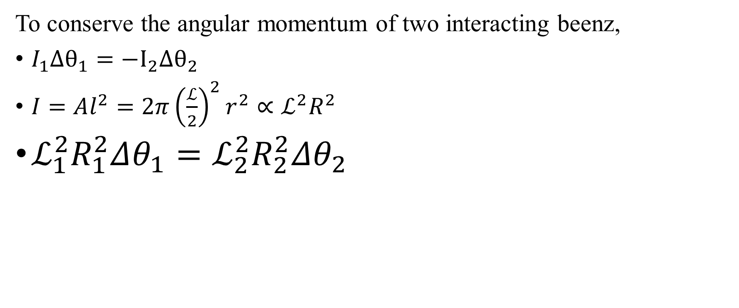
Angular momentum
To conserve the angular momentum of two interacting beenz,
$I_{1}Δθ_{1}=−I_{2}Δθ_{2}$
$I=Al^{2}=2π{\left(\frac{ℒ}{2}\right)}^{2}r^{2}∝ℒ^{2}R^{2}$
$ℒ_{1}^{2}R_{1}^{2}Δθ_{1}=ℒ_{2}^{2}R_{2}^{2}Δθ_{2}$

Slide 15
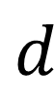
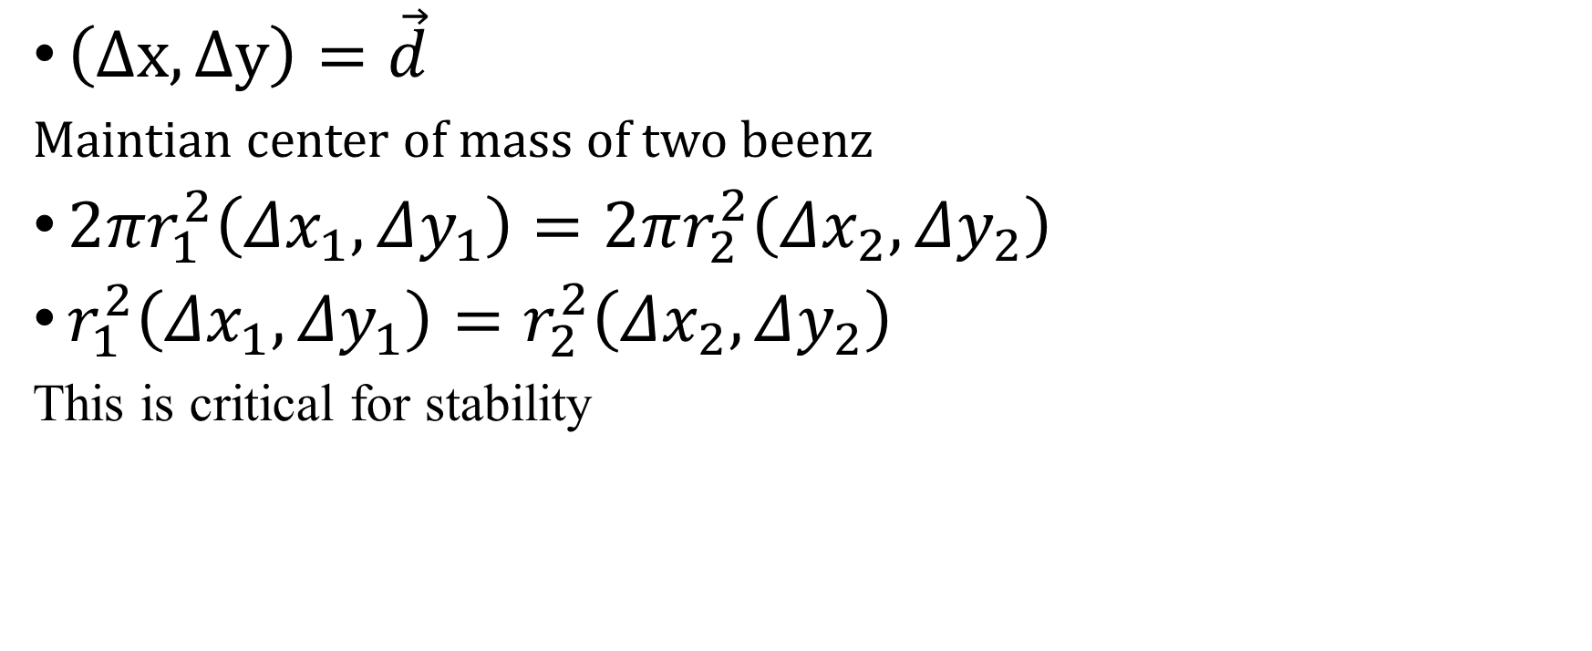
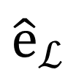
Modification to linear momentum constraint
$${\hat{e}}_{ℒ}$$
$\left(Δx,Δy\right)=\vec{d}$
Maintian center of mass of two beenz
$2πr_{1}^{2}\left(Δx_{1},Δy_{1}\right)=2πr_{2}^{2}\left(Δx_{2},Δy_{2}\right)$
$r_{1}^{2}\left(Δx_{1},Δy_{1}\right)=r_{2}^{2}\left(Δx_{2},Δy_{2}\right)$
This is critical for stability
$$d$$

Slide 16
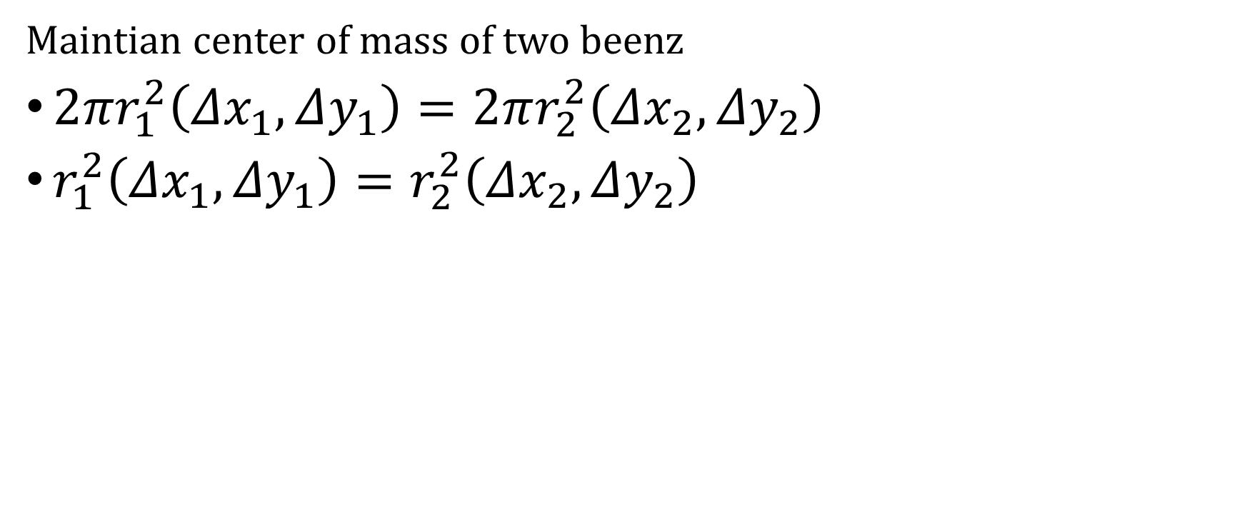
Modification to linear momentum constraint
Maintian center of mass of two beenz
$2πr_{1}^{2}\left(Δx_{1},Δy_{1}\right)=2πr_{2}^{2}\left(Δx_{2},Δy_{2}\right)$
$r_{1}^{2}\left(Δx_{1},Δy_{1}\right)=r_{2}^{2}\left(Δx_{2},Δy_{2}\right)$

Slide 17
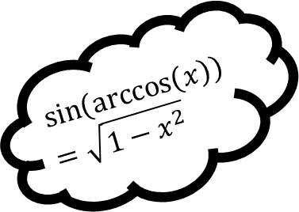
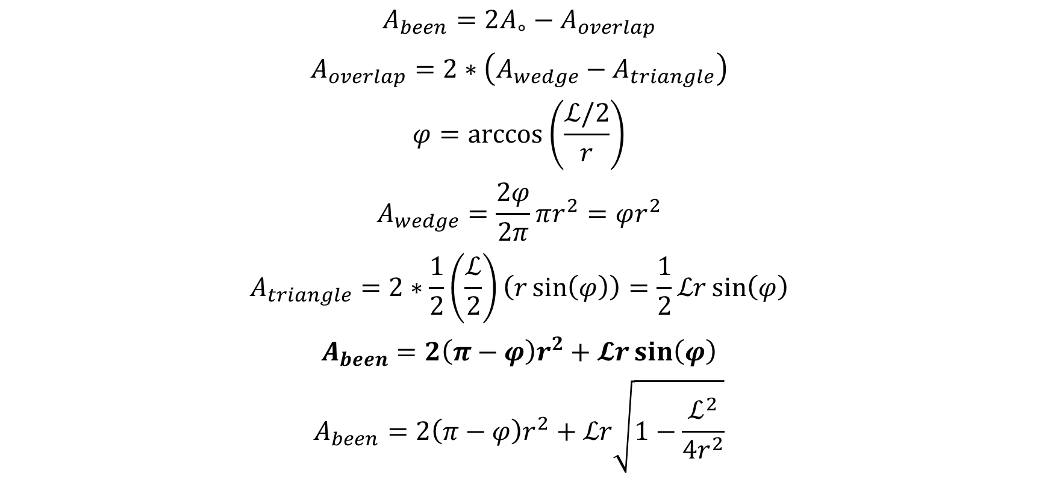
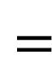

To determine the volume fraction, the area of an individual been must be calculable
$$A_{been}=2A_{∘}−A_{overlap}$$
$$A_{overlap}=2∗\left(A_{wedge}−A_{triangle}\right)$$
$$φ=\arccos\left(\frac{ℒ/2}{r}\right)$$
$$A_{wedge}=\frac{2φ}{2π}πr^{2}=φr^{2}$$
$$A_{triangle}=2∗\frac{1}{2}\left(\frac{ℒ}{2}\right)\left(r\sin\left(φ\right)\right)=\frac{1}{2}ℒr\sin\left(φ\right)$$
$$A_{been}=2\left(π−φ\right)r^{2}+𝓛r\sin\left(φ\right)$$
$$A_{been}=2\left(π−φ\right)r^{2}+ℒr\sqrt{1−\frac{ℒ^{2}}{4r^{2}}}$$
$$−$$
$$=$$
$$\sin\left(\arccos\left(x\right)\right)=\sqrt{1−x^{2}}$$

Slide 18
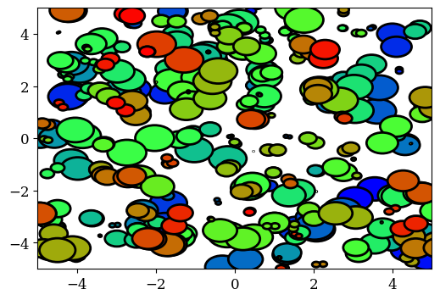
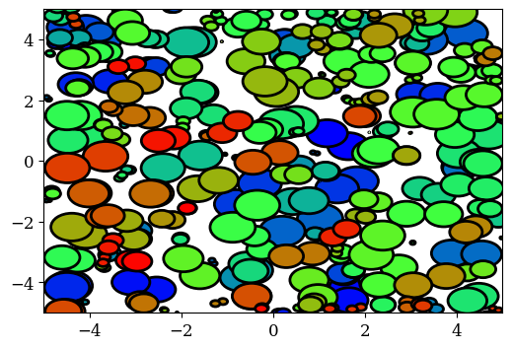
Starting to work
Slightly unstable

Slide 19

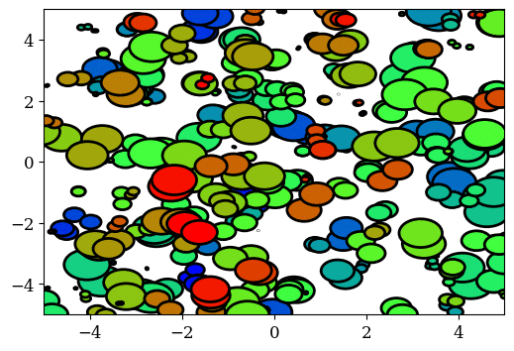


Stability & Step Size
Instability at BC’s
Fixed later by small change in update subroutine
$$h=1$$
$$h=0.5$$
Slightly unstable
Marginally stable

Slide 20
Refrences
[1] T. M. Russell. MesoMake. Unpublished
[2] Skidmore, Cary & Phillips, D.S. & Howe, Philip & Mang, Joseph & Romero, J.A.. (1998). The evolution of microstructural changes in pressed HMX explosives. 10.2172/334323.
[3] R. Mahbub, T. M. Russell, J. D. Borg, R. Coutu, and J. P. Borg, “Geometric Optimization of a Functional Meso-structure with DAKOTA for Surrogate Energetic Heterogeneous Mixture”. AIP Conference, SCCM—2023. Under Review.
[4] Raffee Mahbub, “Investigating The Dynamic Response of Surrogate Energetic Systems with Variable Geometric Complexity”. PhD Thesis, Marquette University. May 2024.
[5] J.W. LaJeunesse, “Dynamic Behavior of Granular Earth Materials Subjected to Pressure-Shear Loading”. PhD Thesis. Marquette University. 2018.
[6] Rawn, Penn, "Reducing Porosity in LPBF TI-6AL-4V by Parameter Optimization and Low Temperature Hot Isostatic Pressing Cycle" Master's Theses. 2023.
[7] Jiang, R., Monteil, L., Kimes, K., Mostafaei, A., & Chmielus, M. (2021). Influence of powder type and binder saturation on binder jet 3D–printed and sintered Inconel 625 samples. The International Journal of Advanced Manufacturing Technology, 116, 3827-3838.

